Slide 1

music defense
Lennert, Efe, Milan, Sergije

Slide 2
Use of apps
Python – game
Adobe Photoshop – graphic elements

Slide 3

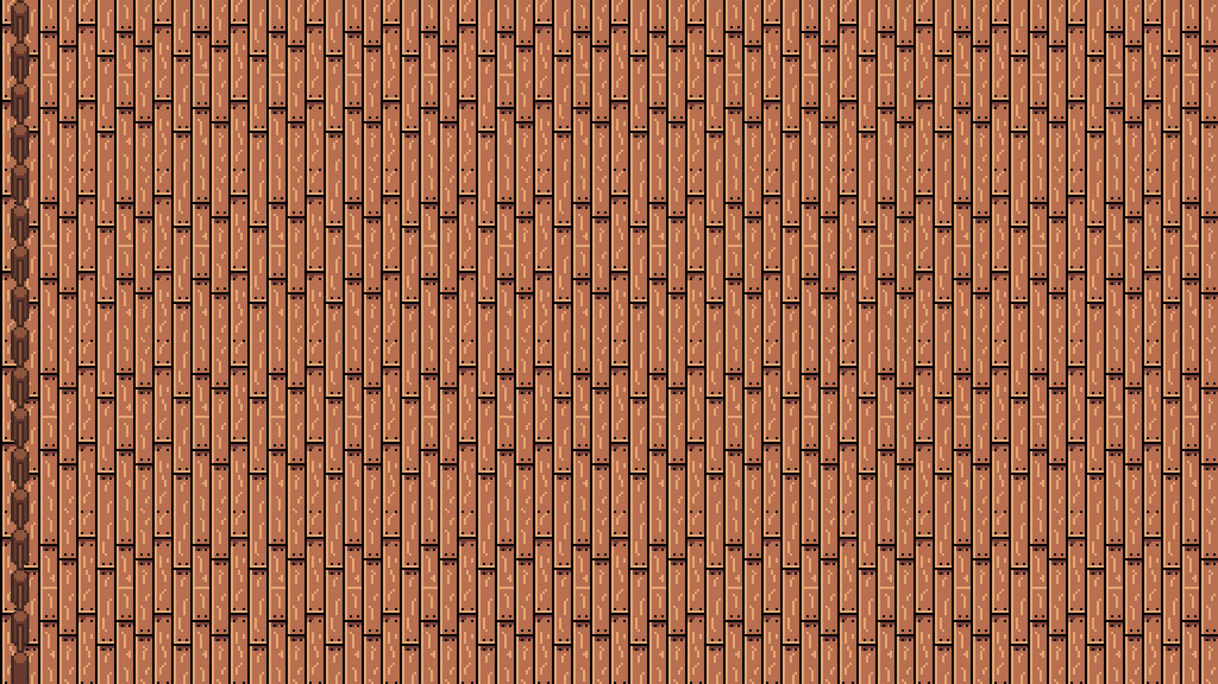
Strong points of the game:
Upgrade system:
Spread
Range
Ammo
Damage
Coin collection
Heart counter

Slide 4
Milan Kriauciaunas:
6th year ICT
programming

Slide 5
Efe Karanfil:
6th year Crossmedia
design

Slide 6
Sergije Petronijevic:
6th year electronics and technical computer science
programming

Slide 7

Lennert Goossens:
6th year Crossmedia
Year work GLM Records
design

